Slide 1
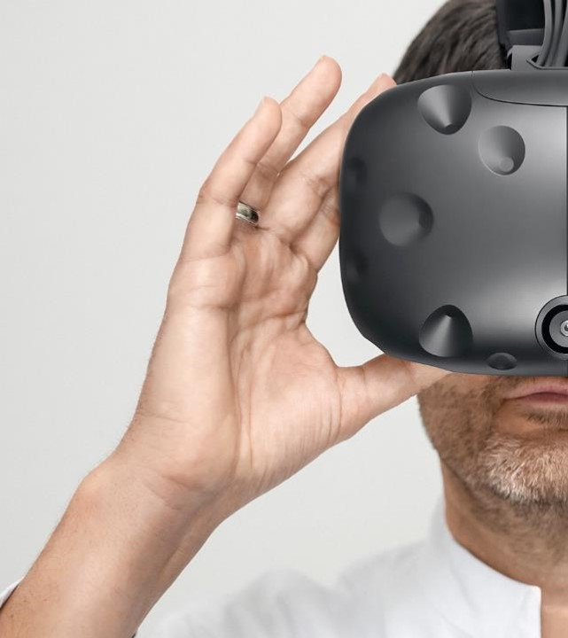
AI in Medicine

Slide 2
Framing AI with art

Slide 3
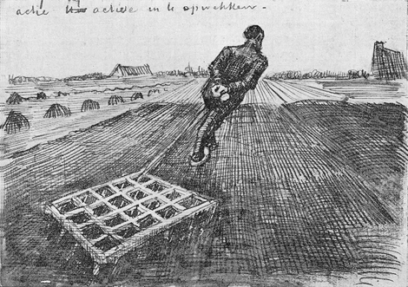
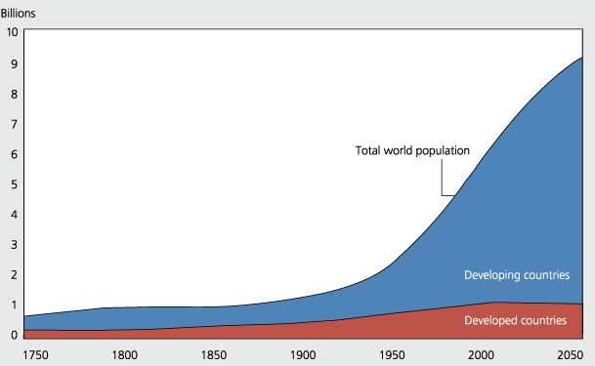
From handcraft to industrialization
Notes:
Romantiziert diese Art der Arbeit zum glück haben wir andre Methoden erfunden…..

Slide 4
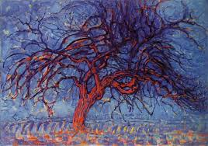
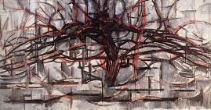
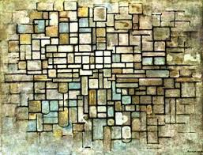
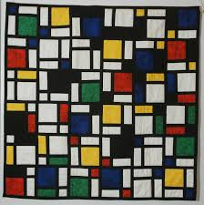
AI is feature extraction

Slide 5
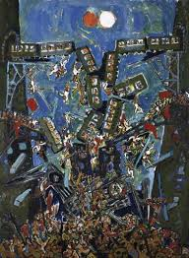
Dürrenmatts Phycisists

Slide 6
AI in Imaging

Slide 7
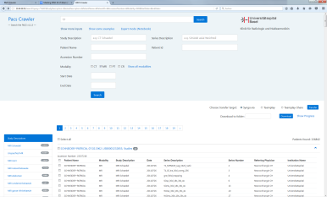
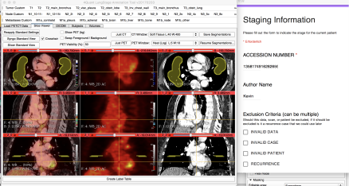
Imaging AI environment
PACS
Search
Engine
Curration/Annotation
Machine
learning
RIS
...
Decision
support
Research
...
Notes:
Hier MD Anderson erwähnen

Slide 8
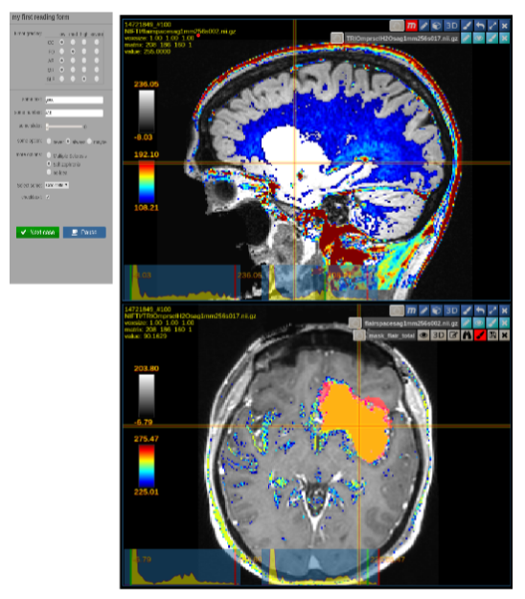
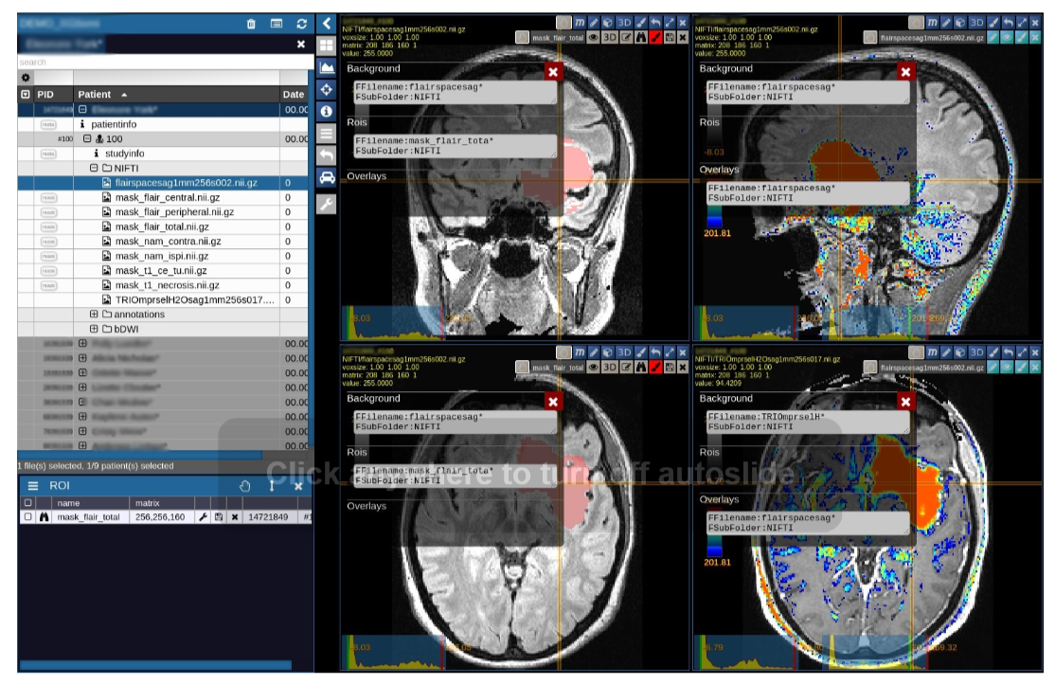

Technical development for annotation: NORA
https://www.nora-imaging.com/

Slide 9
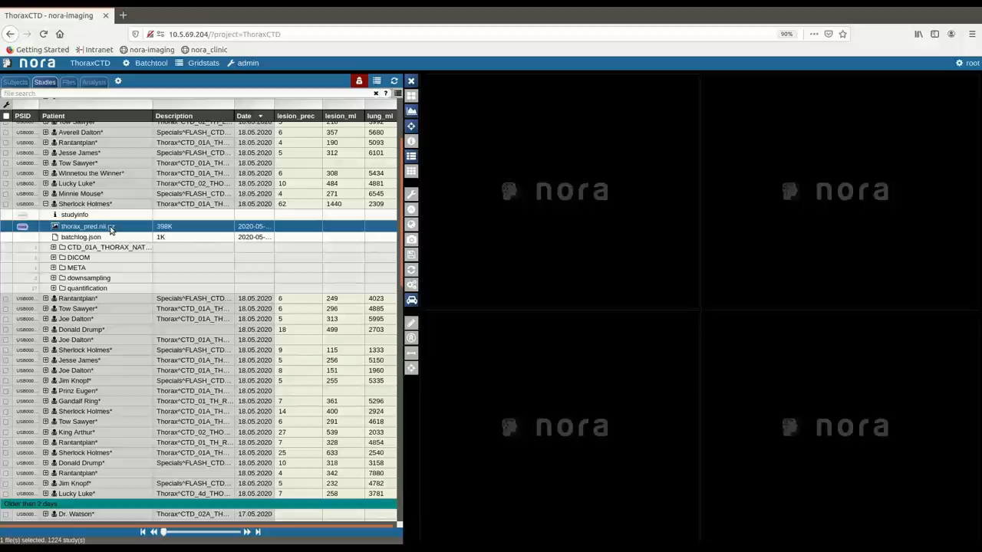
Put the pieces together for Covid-19
Anastasopoulos et al., 2020
Notes:
vi

Slide 10
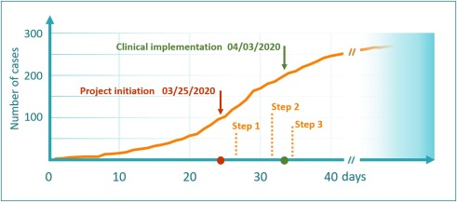
Put the pieces together for Covid-19
Anastasopoulos et al., 2020
Notes:
Used lung segmentation from PET/CT for lung cancer
Used Nora for labeling data
Used nora as DB for training
Used nora for clinical representation

Slide 11
Automated findings detection

Slide 12
AI for Information retrieval and writing

Slide 13
Time spend in EHR-systems
Medical personel works 10h/day
50% is spend in EHR system
Arndt BG et al, Ann Fam Med 2017

Slide 14

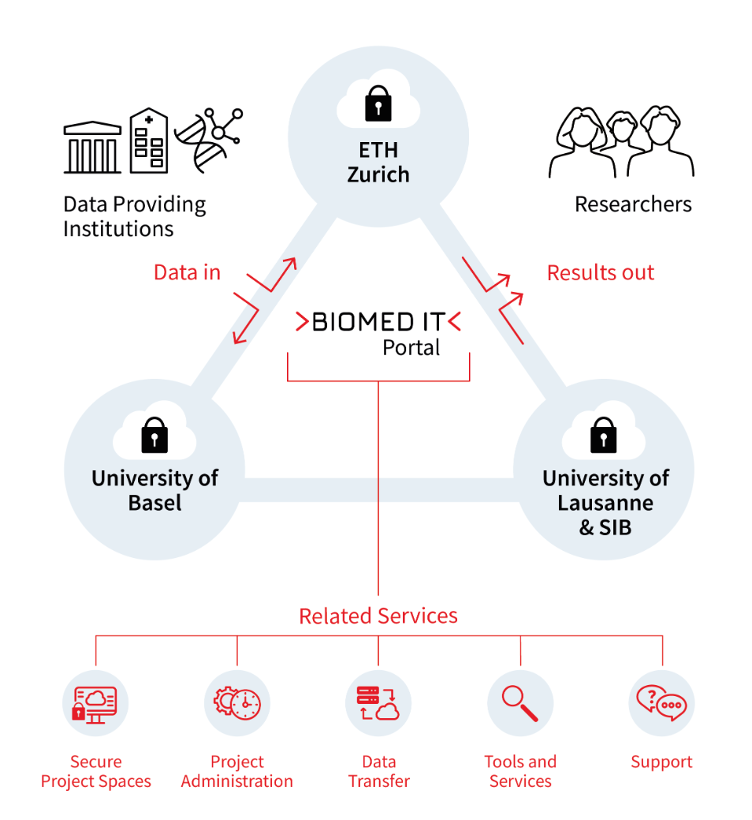

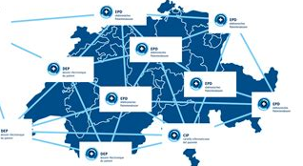

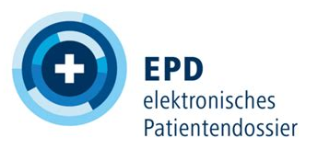
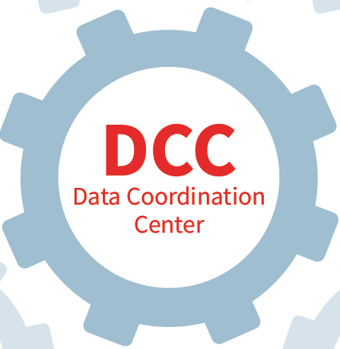
Current state at USB
Primary systems
Analytic environment
Registries
KIS
Read / 24h
Analytic Apps
RIS
Landing
Zone
Read
LIS
DWH
Patho
…
SAP HANA

Slide 15
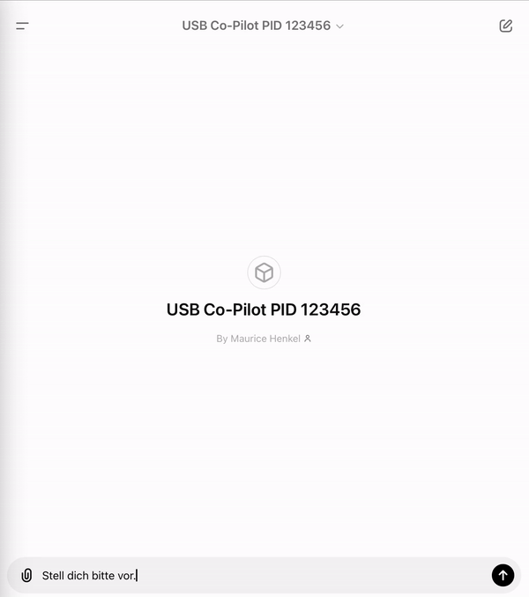
Where is AI in this case?
Primary systems
Analytic environment
Registries
KIS
Read / 24h
Analytic Apps
RIS
Landing
Zone
Read
LIS
DWH
Patho
n=200
SAP HANA

Slide 16





USB Co-Pilot
Patient file
1. MP reads the patient file
3. MP documents
Intervention
1. LLM based summary
3. LLM creates
documentation
2. LLM enhanced proposal
Medical personnel (MP)
Other sources e.g.
Guidelines, SOPs
Report
writing
Patient
conversation
2. MP performs intervention

Slide 17
Solution components: the importance of retrieval augmented generation
DWH
LLaMA 3.1
Mistral Large 2
…
RAG
+
Read
Write
SAP HANA
GPU-Cluster

Slide 18


Add more context..
Guildelines
SOPs
DWH
LLaMA 3.1
Mistral Large 2
…
RAG
+
Read
Write
SAP HANA
GPU-Cluster
Administrative
data

Slide 19
USB Co-Pilot

Slide 20
Future state
Primary systems
Analytic environment
Registries
Formular-Designer
Klinische Apps
Analytische-Apps
Forms
KIS
..
Read/Write
Read
Daten-definitions
Katalog
CDR
DWH
openEHR Framework
SAP HANA
Notes:
interne Ansprechpartnerin / interner Ansprechpartner für weitere Informationen: Florian Rüter (Leiter Qualitätsmanagement)

Slide 21
Full clinical integration as a system that supports high quality data generation
Guildelines
SOPs
Write
LLaMA 3.1
Mistral Large 2
Weitere
Documentation
CDR
RAG
+
GPU-Cluster
Read
Delivers
Information
Administrative
data

Slide 22
Summary
Centralized accessible data is key
The quality of this data is key
Build an R&D environment where you can test
Improve step by step
Don't forget traceability
It is still about improving health

